Slide 1
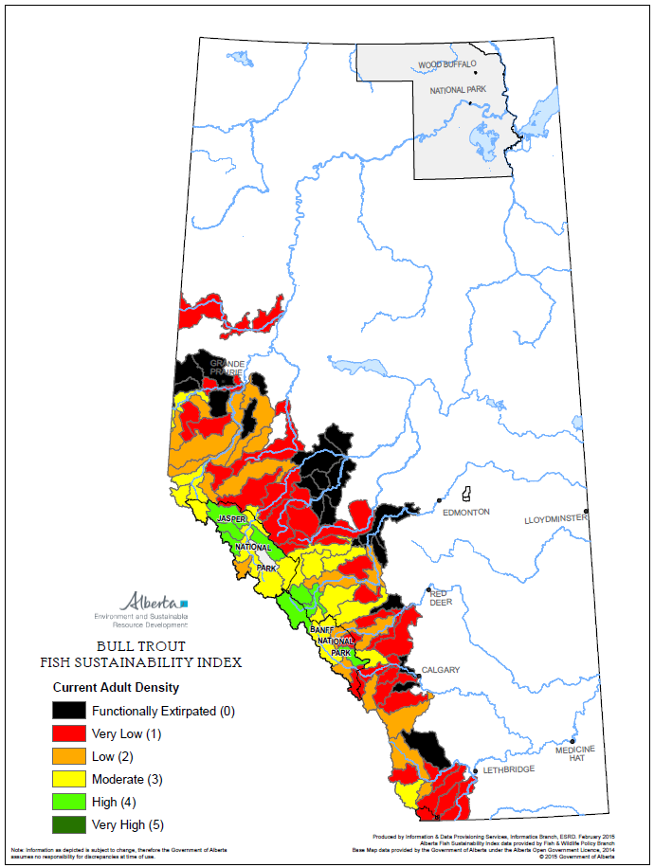
Current adult density of Bull Trout
Colour-categories based on CUE of single-pass
electrofishing = data point
Each watershed’s colour based on average of
a set of data points (ideally >30, in reality far fewer)
Colour = density category that is based on scale anchored at:
Very High density = avg of 5 highest data points in Alberta
= 100%
Scale
Very High density = 100%
High density = 70%
Moderate density = 50%
Low Density = 20%
Very low density =<20%

Slide 2
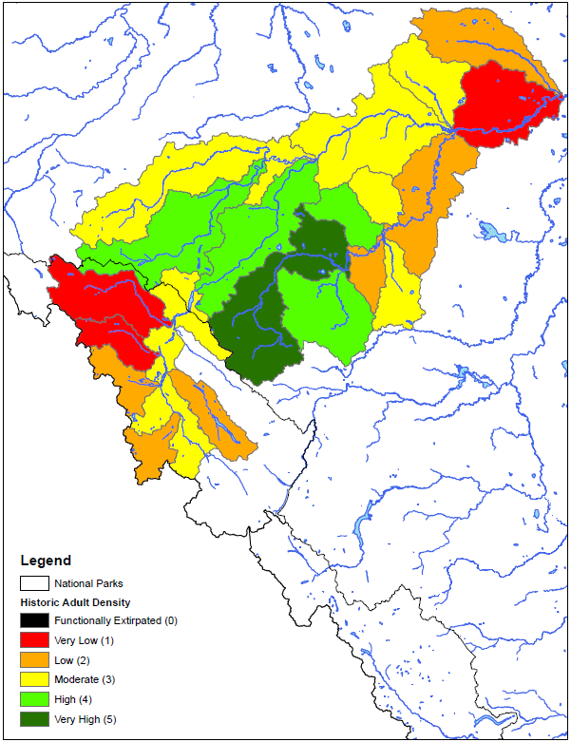
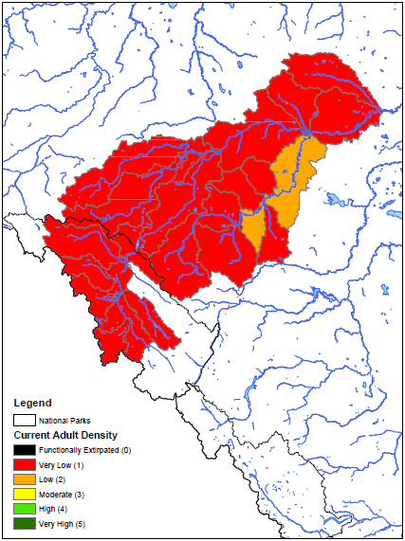
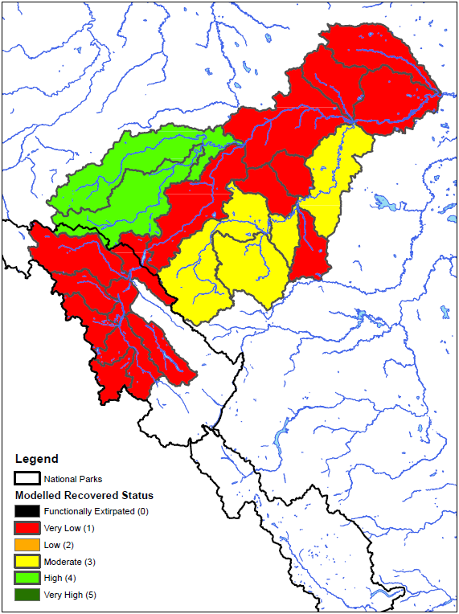
Historical Status
Athabasca Rainbow Trout
2016 Status
2021 Potential Status
Trout Density Thresholds
 | FSI Score | Mature CUE (fish/300m)
100% | 5 | >26
70% | 4 | 18-26
50% | 3 | 13-18
20% | 2 | 5-13
<20% | 1 | <5

Slide 3
Quirk trout densities compared to FSI thresholds

Slide 4
Hinton area Athabasca Rainbow Trout densities 1970 to 2002
40
30
Wampus
Creek
Rainbow Trout Adult density (#/300m)
20
10
Deerlick Creek
Antler Creek
0
Mary Gregg Creek
1970
1980
1990
2000

